Slide 1
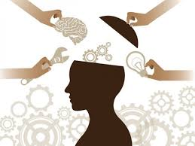
Introduction to Machine Learning
Dr. Kamlesh Kumar kamlesh@smiu.edu.pk

Slide 2
Course Outline
Importance and Concepts of Machine Learning
Supervised Learning
Logistic regression, Perceptron, Generative Learning algorithms
Support Vector Machines, Model Selection and Feature Selection
Evaluating and debugging Learning Algorithms, Learning Theory
Bias/Variance Tradeoff
Unsupervised Learning, K-means, EM Algorithm
PCA (Principal Components Analysis) ICA ( Independent Component Analysis)
Reinforcement Learning and Control

Slide 3
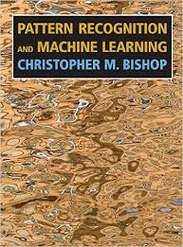
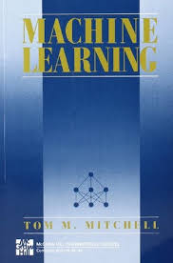
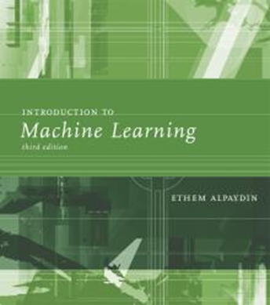
Books to Follow
Bishop, Pattern Recognition and Machine Learning
Machine Learning by Tom Mitchell
Introduction to Machine Learning by Ethem Alpaydin, MIT Press

Slide 4
Prerequisite for this Course
Students should have the knowledge of:
Probability and Statistic
Linear Algebra/Calculus
Preferred language for Machine Learning. (Python, R)

Slide 5
Big Data/Data Science
Widespread use of personal computers and wireless communication leads to “big data”
We are both producers and consumers of data
Data is not random, it has structure, e.g., customer behavior
We need “big theory” to extract that structure from data for
(a) Understanding the process
(b) Making predictions for the future

Slide 6
Why “Learn” ?
Machine learning is programming computers to optimize a performance criterion using example data or past experience.
There is no need to “learn” to calculate payroll
Learning is used when:
Human expertise does not exist (navigating on Mars),
Humans are unable to explain their expertise (speech recognition)
Solution changes in time (routing on a computer network)
Solution needs to be adapted to particular cases (user biometrics)

Slide 7
What We Talk About When We Talk About “Learning”
Learning general models from a data of particular examples
Data is cheap and abundant (data warehouses, data marts); knowledge is expensive and scarce.
Example in retail: Customer transactions to consumer behavior:
People who bought “Blink” also bought “Outliers” (www.amazon.com)
Build a model that is a good and useful approximation to the data.

Slide 8
Data Mining
Application of machine learning methods to large databases is called data mining
Retail: Market basket analysis, Customer relationship management (CRM)
Finance: Credit scoring, fraud detection
Manufacturing: Control, robotics, troubleshooting
Medicine: Medical diagnosis
Telecommunications: Spam filters, intrusion detection
Bioinformatics: Motifs, alignment
Web mining: Search engines
...

Slide 9
What is Machine Learning?
Machine Learning
Study of algorithms that
improve their performance
at some task
with experience
Optimize a performance criterion using example data or past experience.
Role of Statistics: Inference from a sample
Role of Computer science: Efficient algorithms to
Solve the optimization problem
Representing and evaluating the model for inference

Slide 10
Learning system model
Input Samples
Testing
Learning Method
System
Training
Machine Learning General Model

Slide 11
Training and testing
Need to make some assumptions or bias
Training is the process of making the system able to learn.
No free lunch rule:
Training set and testing set come from the same distribution

Slide 12
Training and testing
Data acquisition
Practical usage
Universal set
(unobserved)
Training set (observed)
Testing set
(unobserved)

Slide 13
Performance
There are several factors affecting the performance:
Types of training provided
The form and extent of any initial background knowledge
The type of feedback provided
The learning algorithms used
Two important factors:
Modeling
Optimization

Slide 14
Applications
Association
Supervised Learning
Classification
Regression
Unsupervised Learning
Reinforcement Learning

Slide 15
Learning Associations
Basket analysis:
P (Y | X ) probability that somebody who buys X also buys Y where X and Y are products/services.
Example: P ( chips | beer ) = 0.7

Slide 16
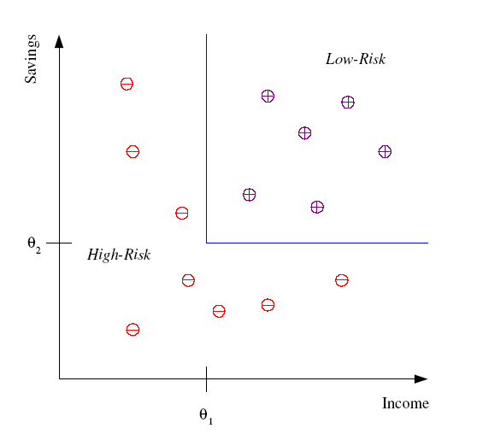
Classification
Example: Credit scoring
Differentiating between low-risk and high-risk customers from their income and savings
Discriminant: IF income > θ₁ AND savings > θ₂
THEN low-risk ELSE high-risk

Slide 17
Classification: Applications
Aka Pattern recognition
Face recognition: Pose, lighting, occlusion (glasses, beard), make-up, hair style
Character recognition: Different handwriting styles.
Speech recognition: Temporal dependency.
Medical diagnosis: From symptoms to illnesses
Biometrics: Recognition/authentication using physical and/or behavioral characteristics: Face, iris, signature, etc
Outlier/novelty detection:

Slide 18








Face Recognition
Training examples of a person
Test images
ORL dataset,
AT&T Laboratories, Cambridge UK

Slide 19
Regression
Let us say we want to have a system that can predict the price of a used car.
Inputs are the car attributes—brand, year, engine capacity, mileage, and other information—that we believe aﬀect a car’s worth.
The output is the price of the car. Such problems where the output is a number are regression problems.

Slide 20
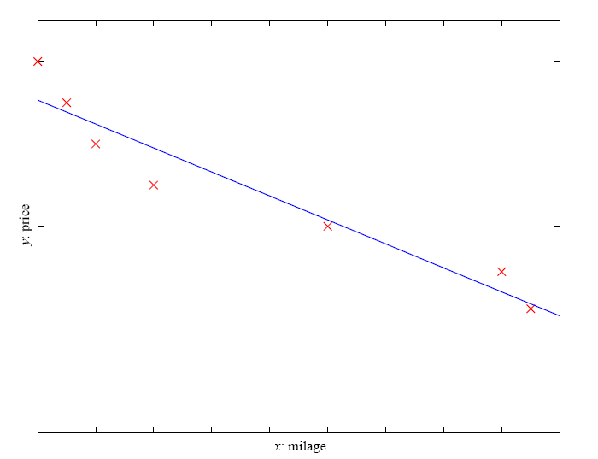
Example 1: Regression
Example: Price of a used car
x : car attributes
y : price
y = g (x | θ )
g ( ) model,
θ parameters
y = wx+w₀

Slide 21
Example 2: Regression
Another example of regression is navigation of a mobile robot.
For example, an autonomous car, where the output is the angle by which the steering wheel should be turned at each time, to advance without hitting obstacles and deviating from the route.
Inputs in such a case are provided by sensors on the car.
For example, a video camera, GPS, and so forth.
Training data can be collected by monitoring and recording the actions of a human driver.

Slide 22
Regression Applications
Navigating a car: Angle of the steering
Kinematics of a robot arm
(x,y)
α₁= g₁(x,y)
α₂= g₂(x,y)
α₂
α₁
Response surface design

Slide 23
Supervised Learning: Uses
Prediction of future cases: Use the rule to predict the output for future inputs
Knowledge extraction: The rule is easy to understand
Compression: The rule is simpler than the data it explains
Outlier detection: Exceptions that are not covered by the rule, e.g., fraud

Slide 24
Unsupervised Learning
Learning “what normally happens”
No output
Clustering: Grouping similar instances
Example applications
Customer segmentation in CRM
Image compression: Color quantization
Bioinformatics: Learning motifs

Slide 25
Reinforcement Learning
Learning a policy: A sequence of outputs
No supervised output but delayed reward
Credit assignment problem
Game playing
Robot in a maze
Multiple agents, partial observability, ...

Slide 26
Resources: Datasets
UCI Repository: http://www.ics.uci.edu/~mlearn/MLRepository.html
Statlib: http://lib.stat.cmu.edu/

Slide 27
Resources: Journals
Journal of Machine Learning Research www.jmlr.org
Machine Learning
Neural Computation
Neural Networks
IEEE Trans on Neural Networks and Learning Systems
IEEE Trans on Pattern Analysis and Machine Intelligence
Journals on Statistics/Data Mining/Signal Processing/Natural Language Processing/Bioinformatics/...

Slide 28
Resources: Conferences
International Conference on Machine Learning (ICML)
European Conference on Machine Learning (ECML)
Neural Information Processing Systems (NIPS)
Uncertainty in Artificial Intelligence (UAI)
Computational Learning Theory (COLT)
International Conference on Artificial Neural Networks (ICANN)
International Conference on AI & Statistics (AISTATS)
International Conference on Pattern Recognition (ICPR)
...

